Slide 1
Git introduction
CS 172 Tutorial Ⅲ
Zhongyi Cai

Slide 2
Outline
Git and GitHub
Basic Knowledge
﻿Basic Usage
Branch Management
Interaction With Remotes

Slide 3
Preliminary-Version Control Systems
Local VCS
Centralized VCS
Distributed VCS
Local Computer
Local Computer
Server
Version Database
Checkout
Version Database
Version 3
User A
Version Database
Version 2
File
Version 3
File
Version 1
Version 3
Computer A
Computer B
File
File
Version 2
User B
Version 2
Version Database
Version Database
File
Version 1
Version 3
Version 3
Version 1
Version 2
Version 2
Version 1
Version 1
·Code versions are stored on server
·Need network to access server
·Collaboration is feasible through
access control
·High dependance on server
·Versions are stored on server and locally
·Developer gets copies and upload
modifications to maintain consensus
·Much more flexible
·Local operation
·Hard to collaborate
Notes:
[1] Git: Version Control for Everyone. In Page12-14.
[2] Git Recipes: A Problem-Solution Approach. In Page 20.

Slide 4
Git and GitHub
-Git is a distributed version control system that can track the history of changes to files and allows multiple
people to collaborate on a project
-Git allows each developer to own a complete code repository, where they can make local changes, commits,
merges, and other operations without relying on a central server.
-Git pros:
Speed, Distributed, Powerful branch management, Security, Open source…
-GitHub is a web-based platform providing code hosting services for version
control using Git as its core technology
-Public and Private repositories
Developer can fork repositories, which could create repository copy
Developer can request pull, which allows developers to propose changes to a
repository and have them reviewed by other developer
Server
Version Database
Version 3
Version 2
Version 1
Computer A
Computer B
File
File
Version Database
Version Database
Version 3
Version 3
Version 2
Version 2
Version 1
Version 1

Slide 5






























Characteristics of Git
·Does not store information as a list of file-based changes, which is commonly described as delta-based version control
·Git thinks of its data more like a series of snapshots. Every time you commit, or save the state of your project, Git
takes a picture of what all your files look like at that moment(the only SHA-l hash) and stores reference to the snapshot
·If files have not changed, Git doesn’t store the file again, just a link to the previous identical file
Checkins Over Time
Checkins Over Time
Version 1
Version 1
Version 2
Version 2
Version 3
Version 3
Version 4
Version 5
Version 1
Version 1
Version 2
Version 2
Version 3
Version 3
Version 4
Version 5
File A
$$A2$$
File A
$$Δ1$$
$$Δ1$$
$$Δ2$$
$$Δ2$$
File A
File A
$$Δ1$$
$$A1$$
$$Δ2$$
$$A1$$
$$A2$$
$$Δ1$$
$$Δ1$$
$$Δ2$$
$$Δ2$$
$$B$$
$$B$$
$$Δ1$$
$$B1$$
$$Δ2$$
File B
$$B2$$
File B
File B
File B
$$Δ1$$
$$Δ1$$
$$Δ2$$
$$Δ2$$
$$Δ3$$
$$Δ3$$
$$Δ1$$
$$C1$$
$$Δ2$$
$$C2$$
$$C2$$
$$Δ3$$
File C
$$C3$$
File C
File C
File C
Delta-based Version Control
Snapshot-based Version Control
Notes:
[1] Pro Git. In Page14-15.
[2] Git Recipes: A Problem-Solution Approach. In Page 22-25.

Slide 6



The History of Git
the Linux kernel was developed using the commercial BitKeeper VCS
Linux development community to develop their own tool
start developing GitHub
2005
2007
the relationship between the community that developed the Linux kernel and the commercial company that developed BitKeeper broke down
Git has evolved and matured to be easy to use
Notes:
[1] BitKeeper与Linux，git史前琐事. (https://blog.csdn.net/glory1234work2115/article/details/51277402 ).
[2] The History of Git: The Road to Domination in Software Version Control. (https://www.welcometothejungle.com/en/articles/btc-history-git )

Slide 7
Outline
Git and GitHub
Basic Knowledge
﻿Basic Usage
Branch Management
Interaction With Remotes

Slide 8
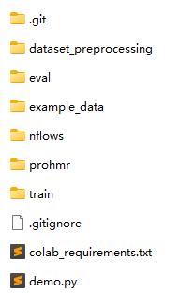
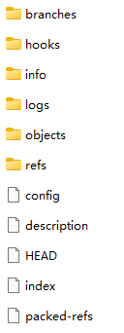
Repositories
Definition^{[1]}: A Git repository is simply a database containing all the information needed to retain and manage the revisions and history of a project.
Working Directory
Repository
File 1
File 2
Version 1
File 3
Version 2
File 1
File 2
File 3
Version 3
File 4
File 5
Notes:
[1] Version Control with Git. In Page31.
[2] What is a git repository. (https://www.geeksforgeeks.org/what-is-a-git-repository/ )

Slide 9
Commits
“git commit” is used to save changes made to the repository.
It creates a new commit object and records the changes made to the repository
A commit is a snapshot of the repository at a specific point in time
Working directory
Working directory
Working directory
project
project
project
file1
foo
bar
file2
file1
quux
bar
file2
file1
quux
bar
file2
Index
after editing file1
Index
Index
after git commit
file1
file2
file1
file2
file1
file2
Object Store
Object Store
Object Store
master
master
master
bd71363
bd71363
a23bf
foo
bar
9d3a2
a23bf
foo
bar
9d3a2
quux
a23bf
foo
bar
9d3a2
quux
Notes:
[1] Version Control with Git. In Page 61-64.

Slide 10
Branch
·A branch is a lightweight movable pointer to a specific commit in a repository's version history.
·It is used to isolate changes made to the codebase so that they do not interfere with the work of other developers.
·Branches allow developers to work in parallel without affecting the main codebase.
Once the changes are complete and tested, they can be merged back into the main branch.
·Default branch is ‘master’, which represents the main codebase
pr-17
master
dev
Notes:
[1] Version Control with Git. In Page 75.

Slide 11
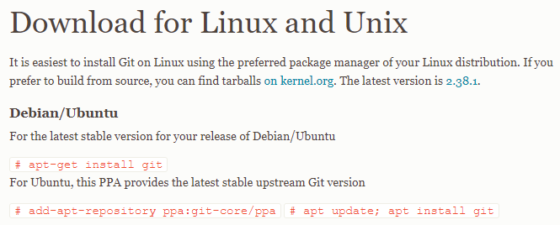
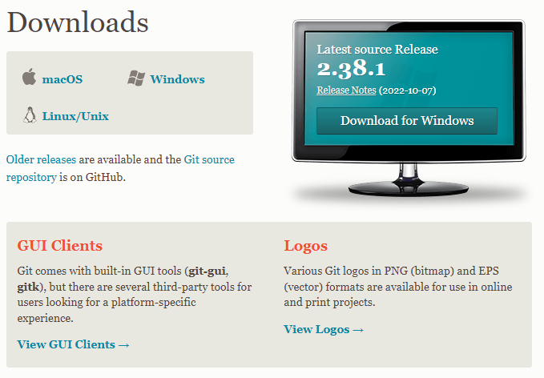
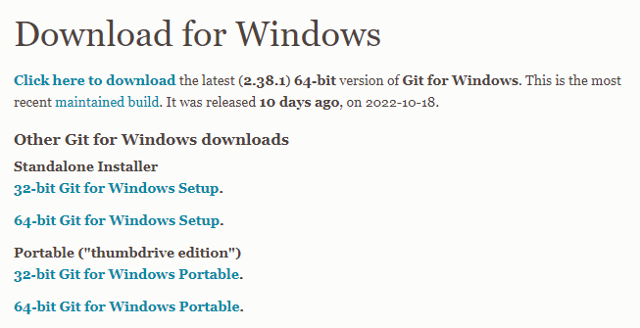
Install Git
Please go to https://git-scm.com/downloads and follow the corresponding instructions.

Slide 12
Executing Commands in Git
git <git-options> <command> <command-options> <operands>
git: command to run git
<git-options>: global options to git itself. e.g. git --work-tree=<path>, git --version
<command>: git command to execute. e.g. git push.
porcelain commands: add, branch, checkout, config, diff…
plumbing commands: cat-file, commit-tree, is-files…
<command-options>: Options to the specified command. e.g. git commit –m “comment”.
<operands>: items for the command to operate on. e.g. git add *.c.
SHA1 value of a commit or a named branch or tag that refers to such a commit
a file or directory on the disk
Notes:
[1] Professional Git. In Page 50.

Slide 13
Git Configuration
git config [<file-option>] name [value]
<file-option>:
--system: every user on the system and all their repositories, stored in [path]/etc/gitconfig.
--global: specific personally to the user, stored in ~/.gitconfig or ~/.config/git/config.
--local: current repository, stored in .git/config.
view all of your settings and where they are coming from:
undo a configuration setting:
git config --list --show-origin
git config --unset <other options> <value to remove>
set your user name and email address
git config --global user.name “your_name”
git config --global user.email “your_email”
Notes:
[1] Pro Git. In Page 21.
[2] more about git config: https://www.yiibai.com/git/git_config.html
[3] Professional Git. In Page 55-60.

Slide 14
Git Configuration Files Scope
System Configuration File
Scope: All users on system
System: <usr|usr/local> /etc/gitconfig
[core]
autocrlf = true
fscache = true
symlinks = false
[pull]
rebase = false
[credential]
helper = manager-core
[credential "https://dev.azure.com"]
useHttpPath = true
[init]
defaultBranch = master
git config --system
Global: ~/.gitconfig
Global Configuration File
Scope: Current user
[user]
email = huochf@shanghaitech.edu.cn
name = huochf
[url "git://github.com/"]
insteadOf = https://github.com/
[url "https//github.com/"]
insteadOf = https://github.com/
[url "https://github.com/"]
insteadOf = https://github.com/
[gui]
Local: <repo dir> /.git/config
git config --global
[core]
repositoryformatversion = 0
filemode = true
bare = false
logallrefupdates = true
[remote "origin"]
url = https://github.com/nkolot/ProHMR.git
fetch = +refs/heads/*:refs/remotes/origin/*
[branch "master"]
remote = origin
merge = refs/heads/master
Direction of Search
Local Configuration File
Scope: Local repository
git config or git config --local
Notes:
[1] Professional Git. In Page 59.

Slide 15
Outline
Git and GitHub
Basic Knowledge
﻿Basic Usage
Branch Management
Interaction With Remotes

Slide 16
Create a Git Repository
Create your own Git Repository from scratch or based on other’s project
Git Init
cd path/to/your/project
git init
Git Clone
git clone <url>

Slide 17
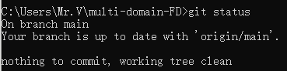
Recording Changes to the Repository
-Files in your working directory are in one of the two states: tracked or untracked
-Tracked files:
Tracked files are files that Git knows about
Include files that were in the last snapshot, newly staged files, which can be unmodified, modified, or staged
-Untracked files:
Any files in your working directory that were not in your last snapshot and are not in your staging area
-When a file is modified, Git recognizes the changes made to the file and adds it to the “unstaged changes”
category. These changes are not yet ready to be committed, as Git needs to be told which changes to include
in the commit.
‘git add’ command adds the changes to the staging area, then we can use ‘git commit’ to save changes
Use ‘git status’ to check the status of your files

Slide 18
Recording Changes to the Repository
The lifecycle of the status of files in Git.
Tracked
Untracked
Unmodified
Modified
Staged
Add the file
Edit the file
Edit the file
Stage the file
Remove the file
Commit
Notes:
[1] Pro Git. In Page 28.

Slide 19
Recording Changes to the Repository
check the status of your files:
remove file:
git status
git rm
tracking new files:
move file:
git add
git mv
view your staged and unstaged changes:
ignore files:
marked in .gitignore file
for example:
$ cat .gitignore
*.[oa]
*~
git status
git diff
commit your changes
git commit
Notes:
[1] Pro Git. In Page 28-40.

Slide 20
Process Visualization
Local Repository
Local Repository
Local Repository
Local Repository
(3)a
commit
commit
commit
commit
Staging Area
Staging Area
Staging Area
Staging Area
(2)a
add
add
add
add
Working Directory
Working Directory
Working Directory
Working Directory
(1)a
(1)a
(1)a
Notes:
[1] Version Control with Git. In Page 39-57.
[2] Professional Git. In Page 106-109.

Slide 21
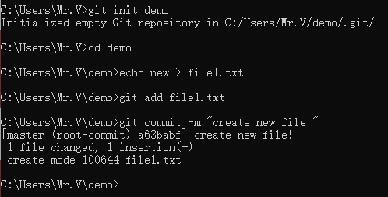
One simple example
Step:
Create a file in the working directory
Stage the file
Commit the file

Slide 22
Undoing Things
Methods to undo modification or backtrack versions
-git reset:
Used to move the current branch to a different commit
--soft, leave the changes in the staging area
--mixed(default), remove the changes from the staging area
--hard, discard all changes in the working directory and staging area
-git revert:
Used to undo a previous commit by creating a new commit that
reserves the changes made by previous commit
It does not rewrite the history of the repository and can be used
to undo changes that have already been pushed to a remote
repository
git commit --amend
Reset -- Rolling Back Changes:
git reset
Completely Resetting the Local Environment:
git reset --hard
Revert – Canceling Out Changes
git revert
Notes:
[1] Pro Git. In Page 44-46.
[2] Professional Git. In Page 145-147.

Slide 23
Undoing Things
Starting Repository Contents
git reset --hard 87ba8bc
Local Repository
HEAD
HEAD
Local Repository
87ba8bc
43bd3ef
d21be2c
87ba8bc
43bd3ef
d21be2c
tag: current
tag: current
Line 1
Line 1
Line 2
Line 1
Line 2
Line 3
Line 1
Line 1
Line 2
Line 1
Line 2
Line 3
Staging Area
Working Directory
Staging Area
Working Directory
XYZ
ABS
Line 1
Line 1
Notes:
[1] Professional Git. In Page 148-150.

Slide 24
Undoing Things
git reset current~1 [--mixed]
git revert HEAD~1
HEAD
Local Repository
Local Repository
HEAD
87ba8bc
43bd3ef
d21be2c
87ba8bc
43bd3ef
d21be2c
c1c8bd4
tag: current
tag: current
Line 1
Line 1
Line 2
Line 1
Line 2
Line 3
Line 1
Line 1
Line 2
Line 1
Line 2
Line 3
Line 1
Line 2
Staging Area
Working Directory
Staging Area
Working Directory
Line 1
Line 2
Line 1
Notes:
[1] Professional Git. In Page 148-150.

Slide 25
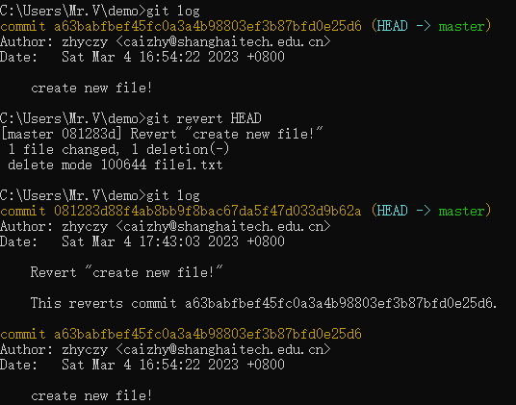
One simple example

Slide 26
Outline
Git and GitHub
Basic Knowledge
﻿Basic Usage
Branch Management
Interaction With Remotes

Slide 27
Branch
·A branch is a lightweight movable pointer to a specific commit in a repository's version history.
·It is used to isolate changes made to the codebase so that they do not interfere with the work of other developers.
·Branches allow developers to work in parallel without affecting the main codebase.
Once the changes are complete and tested, they can be merged back into the main branch.
·Default branch is ‘master’, which represents the main codebase
pr-17
master
dev
Notes:
[1] Version Control with Git. In Page 75.

Slide 28
Creating a Branch
git branch <branch name>
Concrete Example:
Create a new branch named testing. A new pointed named testing is created that points to the most current commit(The same one the master currently points to)
HEAD
HEAD
master
master
87ba8bc
43bd3ef
d21be2c
87ba8bc
43bd3ef
d21be2c
staring chain of commits
after the creation of a testing branch
testing
Notes:
[1] Professional Git. In Page 162.

Slide 29
Checking Out a Branch
git checkout <branch name>
Once a branch exists, you can get content from it using the checkout command
The following is the example to get the latest version from testing
HEAD
master
master
87ba8bc
43bd3ef
d21be2c
87ba8bc
43bd3ef
d21be2c
testing
after checking out the testing branch
after the creation of a testing branch
testing
HEAD
Notes:
[1] Professional Git. In Page 163.

Slide 30
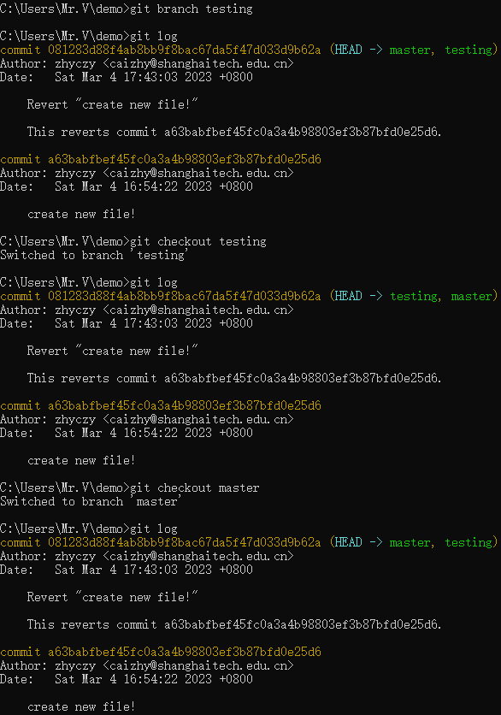
One simple example

Slide 31
Adding Content to a Branch
master
master
87ba8bc
43bd3ef
d21be2c
87ba8bc
43bd3ef
d21be2c
c1c8bd4
testing
testing
after checking out the testing branch
after a subsequent commit is made
HEAD
HEAD
Notes:
[1] Professional Git. In Page 164.

Slide 32
Other Useful Command
Get Information about Branches:
git branch
Delete a Branch:
git branch –d <name>
Rename a Branch:
git branch –m <name> <new_name>
Notes:
[1] Professional Git. In Page 168-171.

Slide 33
Merge Branch
git merge <source_branch>
This command will merge the changes from the specified source branch into the current branch
‘git merge’ can result in conflicts if changes have been made to the same file or lines of code in both the source and destination branches.
When a merge conflict occurs, git will pause the merge and allow you to manually resolve the conflicts
Once you resolve the conflicts, use ‘git merge --continue’ to complete the merge
Demo for Fast-Forward Merge:
$ git checkout master
$ git merge fix
master
fix
master
fix
C1
C2
C3
C4
C5
C1
C2
C3
C4
C5
setup for the fast-forward example
the fast-forward merge
Notes:
[1] Professional Git. In Page 195-196.

Slide 34
Merge Branch
Demo for Three-Way Merge:
master
master
master
C2
C4
C1
C2
C4
C1
C2
C4
C5
C1
C2
C4
C6
(common ancestor)
(common ancestor)
C3
C5
C3
C5
C3
C5
fix
fix
fix
the three points considered for the three-way merge
the three-way merge process
the new merge commit after the three-way merge
Notes:
[1] Professional Git. In Page 196-199.

Slide 35
Rebasing – Merging with History
git rebase branch2 [branch1]
Used to apply a sequence of commits from one branch onto another
It moves the entire branch(branch1 or current branch) to begin on top of the destination branch(branch2)
master
master
master
feature
C1
C2
C4
C1
C2
C4
C1
C2
C4
C3’
C5’
(common ancestor)
(common ancestor)
(common ancestor)
C3
C5
C3
C5
C3
C5
feature
feature
setup for the rebase example
compute deltas from source branch
apply deltas on the destination tip
Notes:
[1] Professional Git. In Page 199-202.

Slide 36
Outline
Git and GitHub
Basic Concept
﻿Basic Usage
Branch Management
Interaction With Remotes

Slide 37
Commands with Remotes
show your remotes:
push to your remote:
git remote
git push <remote> <branch>
add remote repositories:
inspect a remote:
git remote add
git remote show origin
get data from your remote projects:
rename and remove remotes
git fetch <remote>
git remote rename
get data and merge it into your work:
git pull <remote>
Notes:
[1] Pro Git. In Page 51-.

Slide 38

Develop projects with GitHub
Access github.com to sign up with your email (education mailbox is recommended)

Slide 39
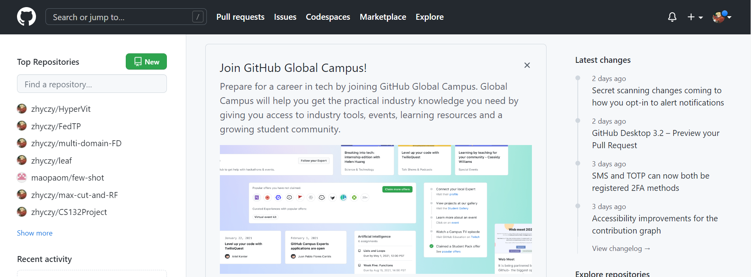
Develop projects with GitHub
Interface Introduction

Slide 40
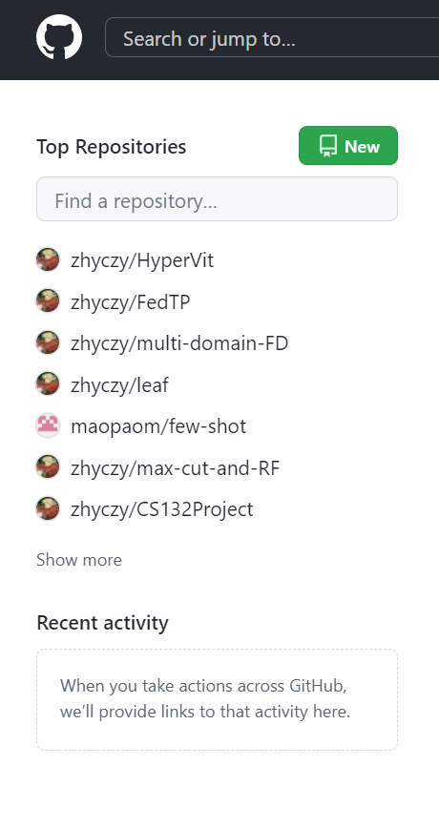
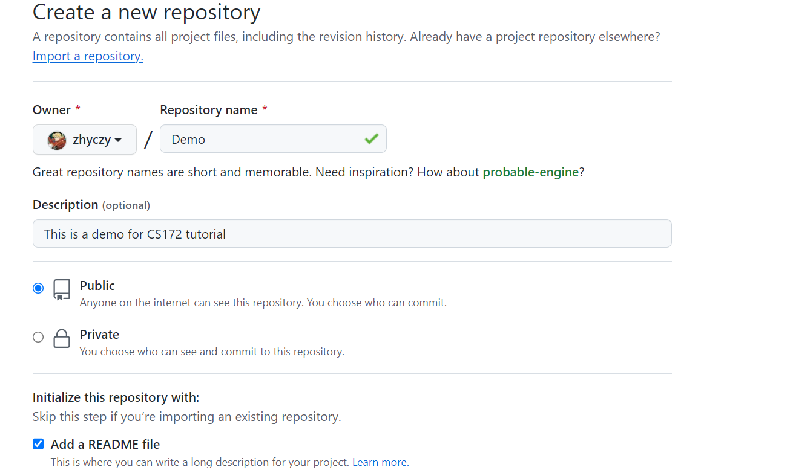
Establish your new project
Establish your repository from scratch

Slide 41
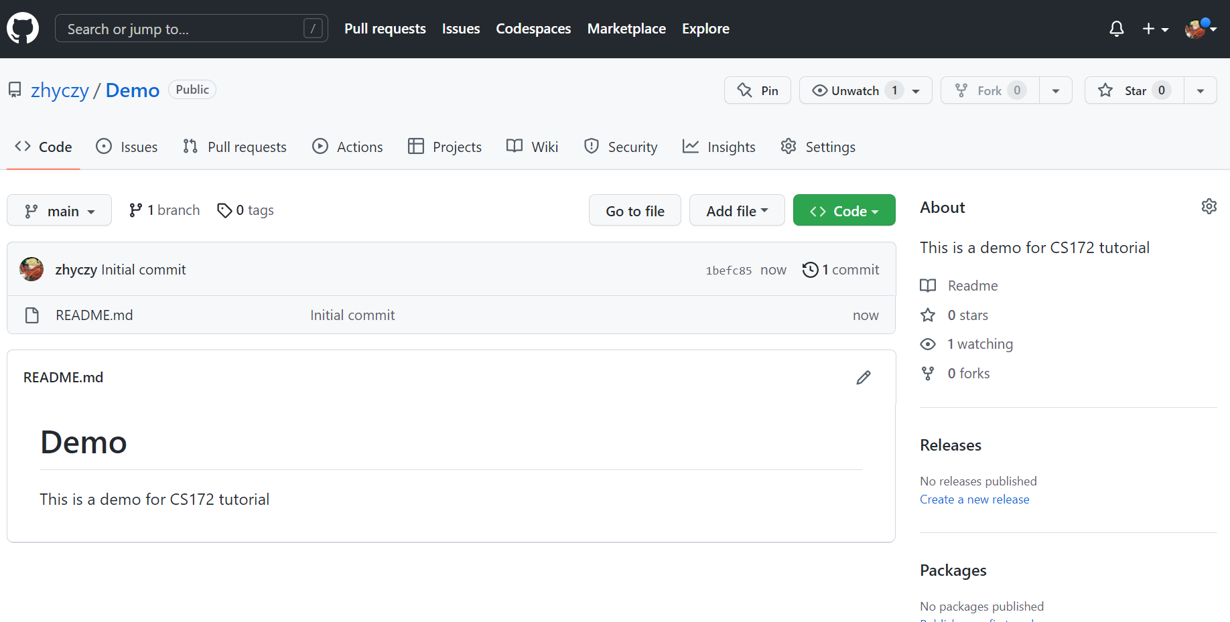
Establish your new project
Establish your repository from scratch

Slide 42
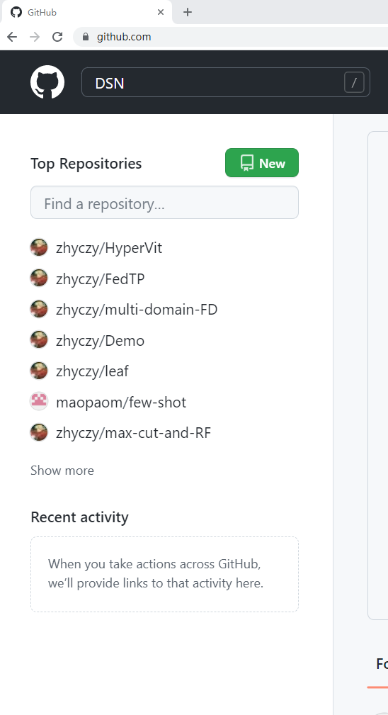
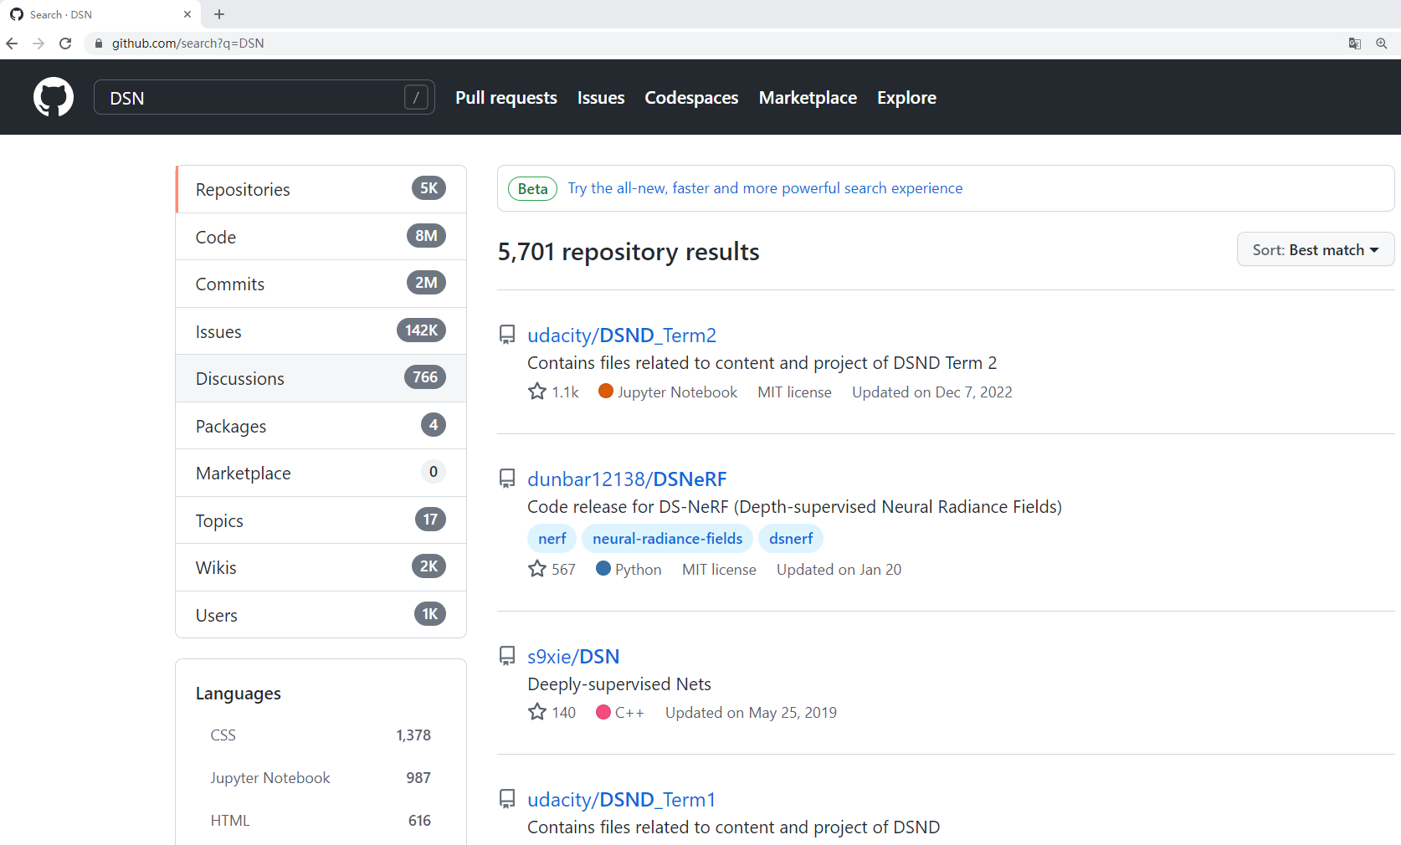
Establish your new project
Establish your project standing on former developers’ shoulders

Slide 43
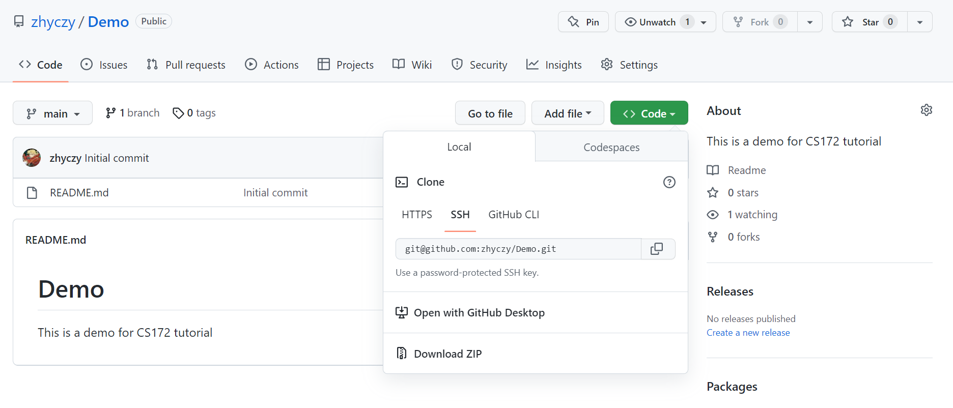
Git Clone

Slide 44
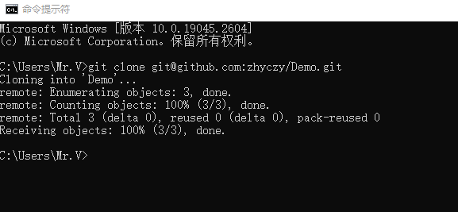
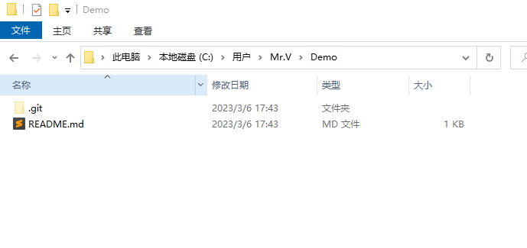
Git Clone
Download files from the server to the local device

Slide 45
Git Clone
HEAD
origin/HEAD
HEAD
master
origin/master
master
87ba8bc
43bd3ef
d21be2c
c1c8bd4
Clone
87ba8bc
43bd3ef
d21be2c
c1c8bd4
Local Repository
testing
testing
Remote Repository
(master)
Working Directory
Notes:
[1] Professional Git. In Page 330-333.

Slide 46
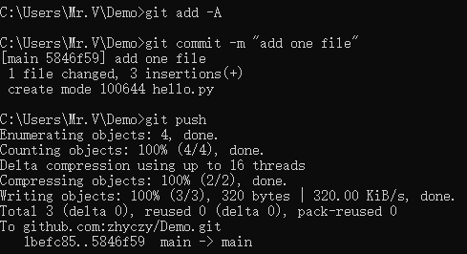
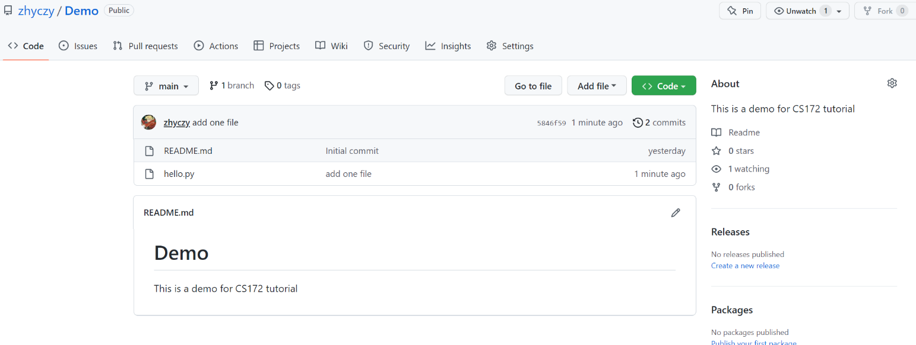
Git Push
Synchronize the local device and the server
·Make any modifications in the local repository
·Git commit locally
·Git push
Notes:
[1] Professional Git. In Page 330-333.

Slide 47
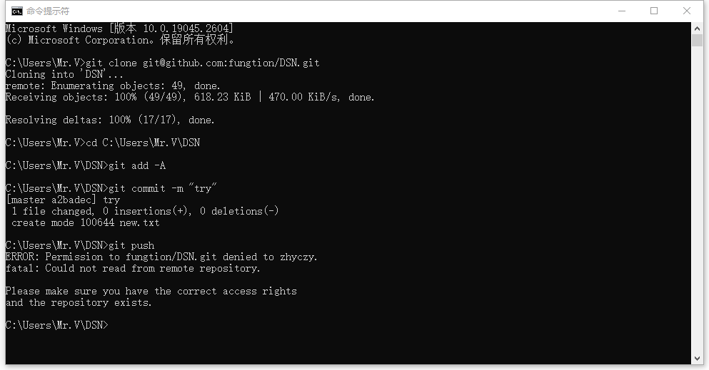
Git Push
Authority management

Slide 48
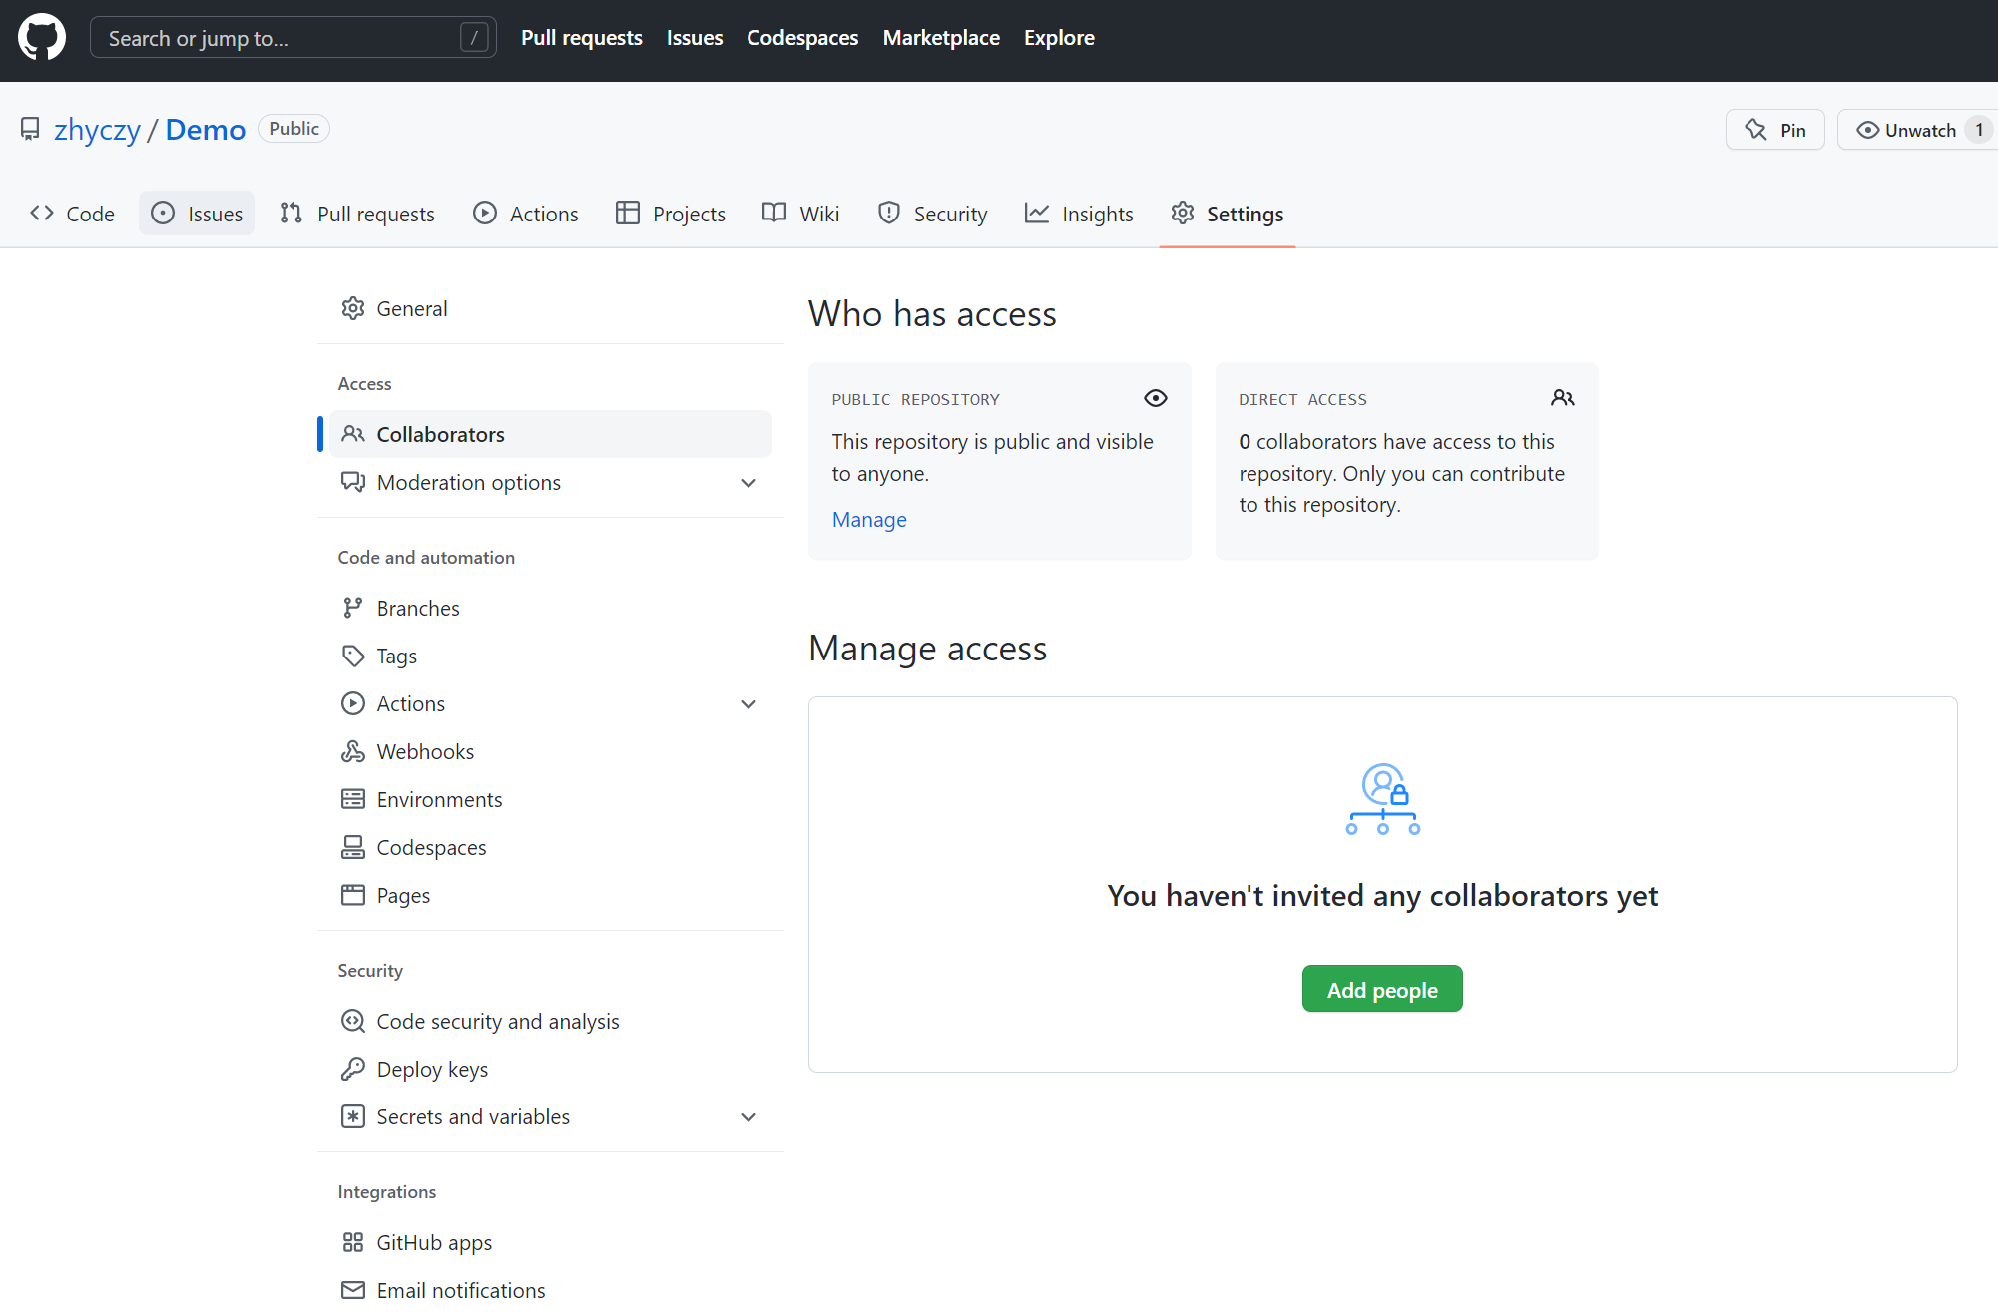
Git Push
Authority management

Slide 49
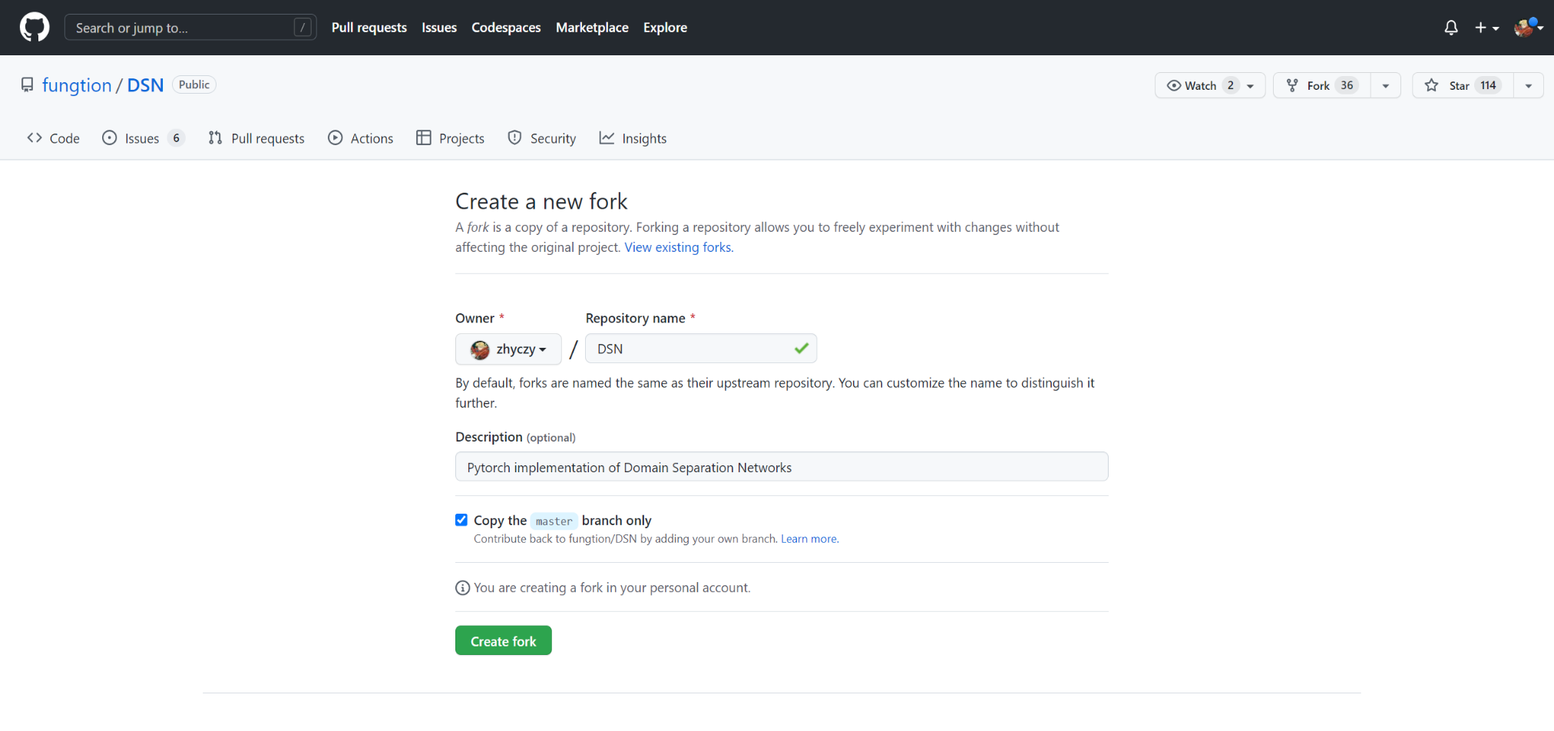
Fork and Request Pull
In Git-based version control systems(GitHub…), a fork is a copy of a repository that is hosted on the same platform but belongs to another user.
Forking allows users to freely experiment with changes without affecting the original project
You can submit a pull request to the original repository’s owner, asking them to review and potentially merge your changes into the original project

Slide 50
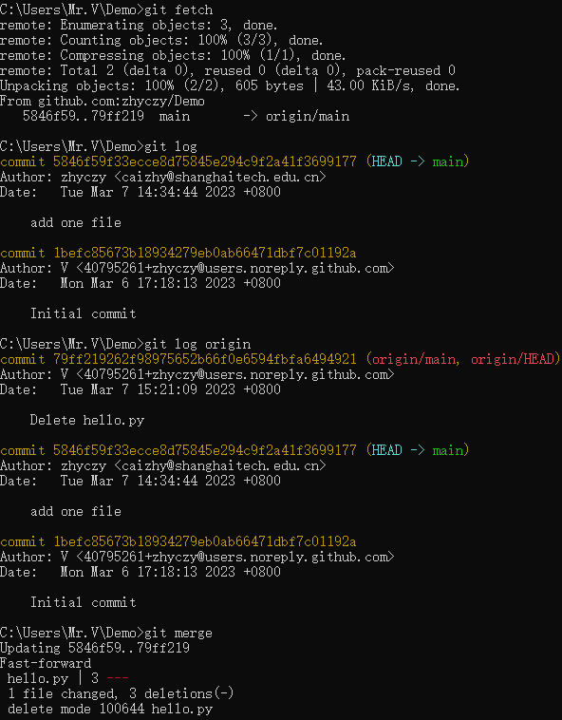
Git Fetch
·Used to retrieve the latest changes from a repository
without merging the changes into your local branch
·Then use git log <remote name> to check
·Use git merge to merge

Slide 51
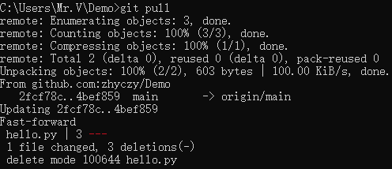
Git Pull
·Used to retrieve the latest changes from a remote
repository and merge them into your local branch
·git fetch + git merge

Slide 52
Configure SSH Key
SSH key:
A Git SSH key is a way to securely authenticate with a Git server over SSH
When you generate an SSH key, it creates a public and private key pair.
The local private key is stored on your local machine, while the public key is uploaded to the Git server.
Every time when you try to connect to the Git server, the server will compare the public key to the private key. If matched, you are granted access to the Git server
User identification so that we do not need to log in personal GitHub account every time by inputting user name and password
Configuration:
Take the Windows Operation system as an example
macOS and Linux systems have little differences. If needed, you can teach yourself by mimicking the configuration process in Windows.
Refer to: https://blog.csdn.net/qq_37525899/article/details/88807931

Slide 53
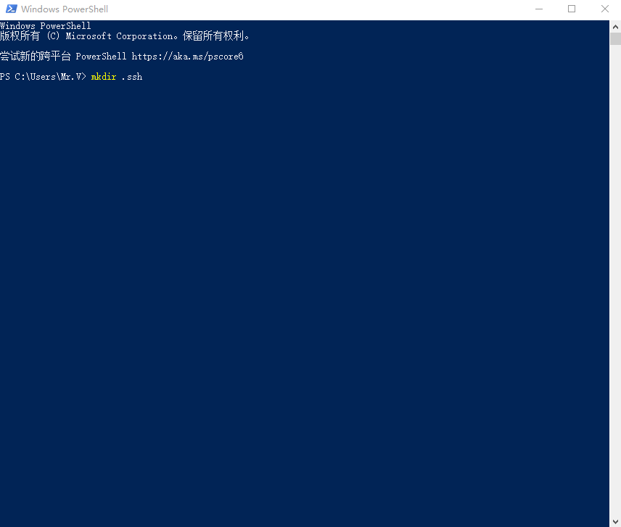
Configure SSH Key
1. Open the command line interface
Two methods to enter this interface:
·Search PowerShell
·Enter admin file then open it
mkdir .ssh

Slide 54
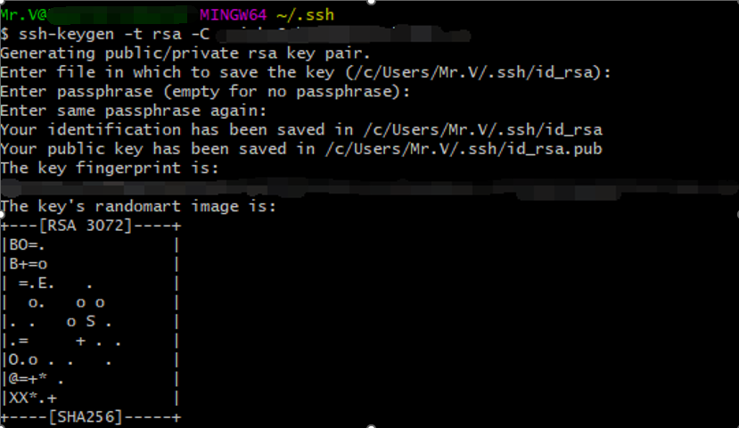
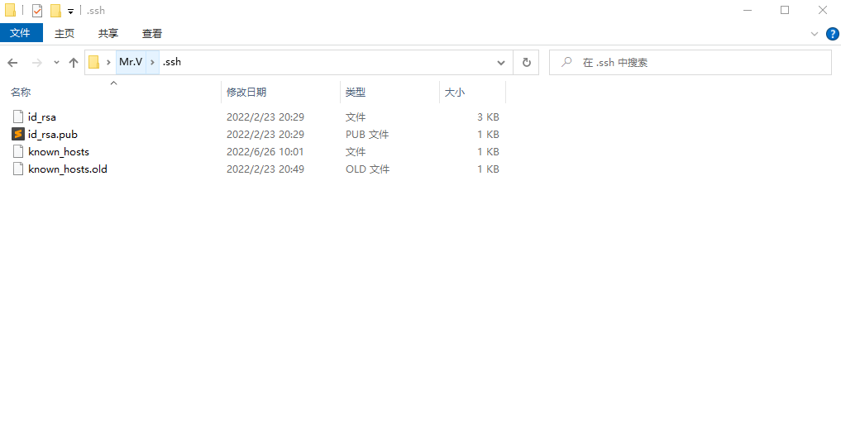
Configure SSH Key
2. Enter the folder ‘.ssh’, right click and choose ‘Git bash here’
Input ssh-keygen -t rsa –C ‘your email address’
After you finish this, id_xxx and id_xxx.pub should appear in folder ‘.ssh’

Slide 55
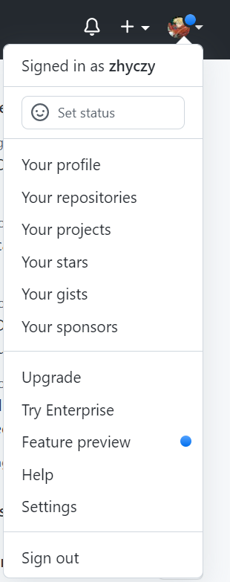
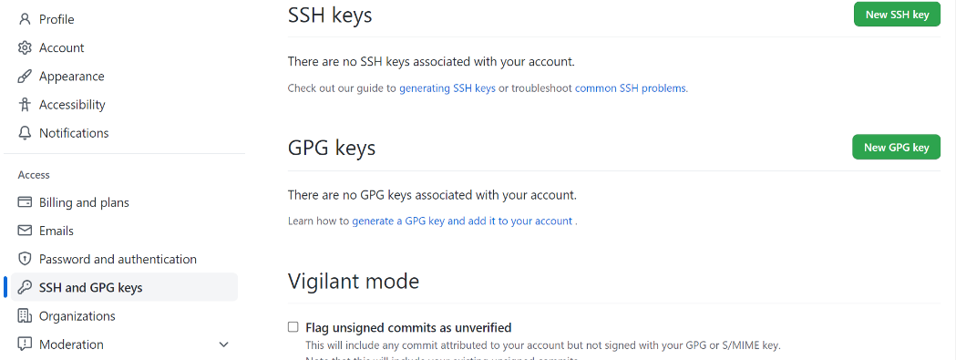
Configure SSH Key
3. Open .pub and copy all the contents
4. Enter settings, click ‘New SSH key’

Slide 56
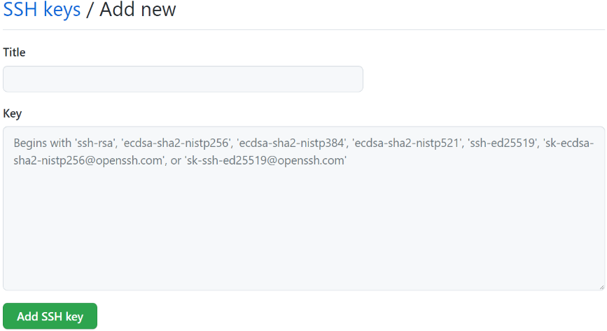
Configure SSH Key
5. Paste all the content into the ‘Key’ area and give a title, click ‘Add SSH key’
6. Go back to git command line interface and set local default identity:
git config --global user.email “you@example.com”
git config --global user.name “your name”

Slide 57


References

Slide 58
Resources
Ebooks：
Introduction to Git and Github. https://github.com/bobbyiliev/introduction-to-git-and-github-ebook https://git.bobby.sh
Git Community Book. https://shafiul.github.io/gitbook/index.html
Git: Version Control for Everyone. https://vdoc.pub/download/git-version-control-for-everyone-68iv7r5hnsj0
Free Git Books. https://github.com/miollek/Free-Git-Books
The 20 Best Git Books for Newbie and Professional Programmers. https://www.ubuntupit.com/best-git-books-for-newbie-and-professional-programmers/
Git Official Website. https://git-scm.com

